Slide 1
tc flow setup rates
Preliminary results

Slide 2

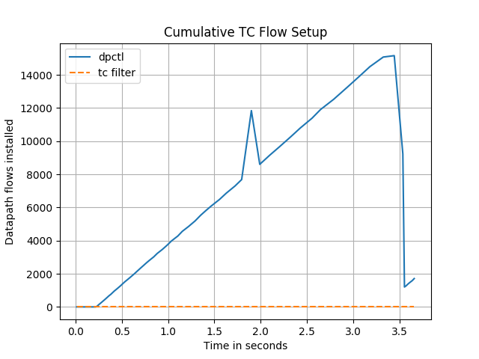
OVS flow setup

Slide 3
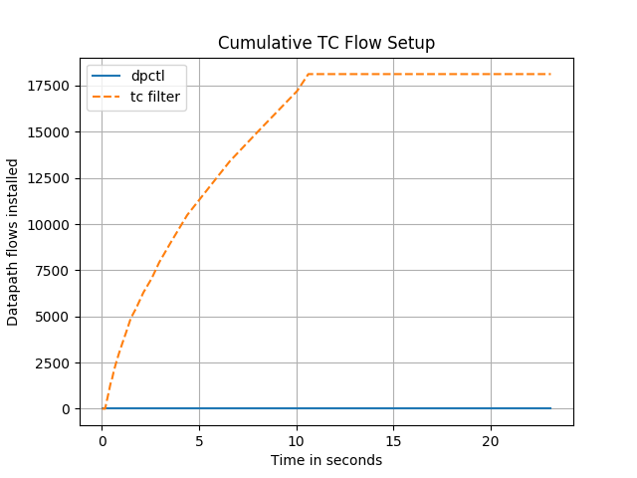
tc flow setup

Slide 4
Thank You

